Slide 1
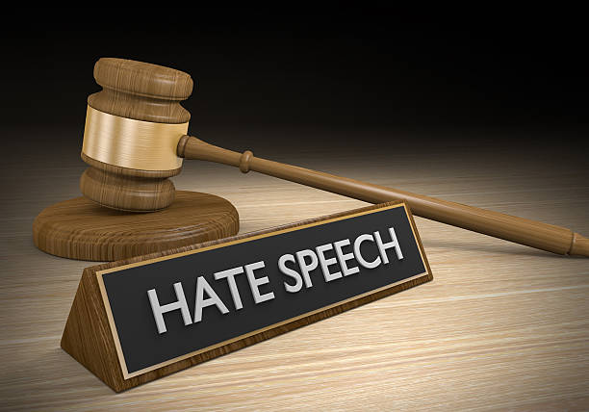
Hate Speech Detection Using NLP
Group 3
Group Members
Bidash Gurung
Pema Chozom
Dorji Thogmey

Slide 2
Overview
Introduction and Problem Statement.
Aims and Objectives.
Model Overview
Demonstration

Slide 3
Problem
Statement

Slide 4
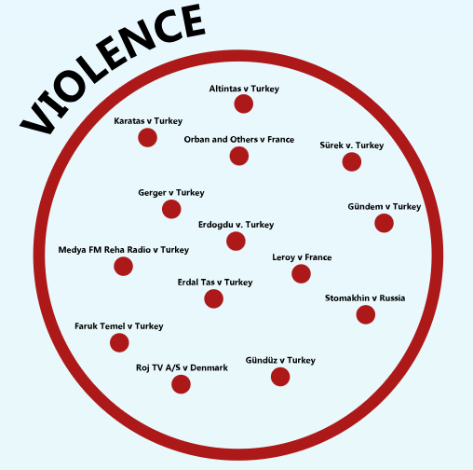
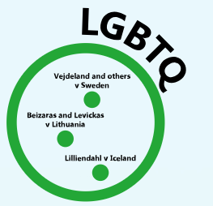

Advances in social media leads to more forms of hate speech.
Creates division and incites violence.
Need for Enhanced Detection Methods

Slide 5
AIMS

Slide 6
Develop a Hate Speech Detection System:
Use NLP techniques to identify hate speech on social media.
Improve Contextual Understanding:
Focus on context-aware models to differentiate between offensive language and indirect hate speech.
Categorization of Hate Speech:
Classify hate speech into categories like homophobia, racism, sexism, and xenophobia.

Slide 7
OBJECTIVES

Slide 8
Develop a robust dataset for hate speech detection
Design and implement a context-aware NLP model
Evaluate model performance on real-world social media data
Design and implement an NLP model for classifying hate speech detected

Slide 9
Literature Review

Slide 10
Evolution of Hate Speech Detection:
Transition from traditional methods (SVM, Naive Bayes) to deep learning (LSTM, BERT).
Transformer models show improved accuracy in identifying complex linguistic features.
Real-time Hate Speech Detection:
Focus on efficiency using RNNs and attention mechanisms.
Hybrid models achieve over 85% accuracy.

Slide 11
Methodology Overview

Slide 12
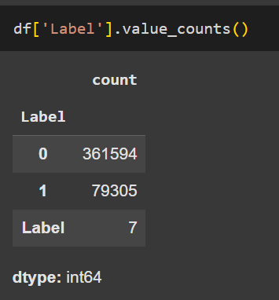

Data Collection:
Use CSV datasets with labeled hate speech from kaggle.
1 - hate comment
0 - non-hate comment

Slide 13
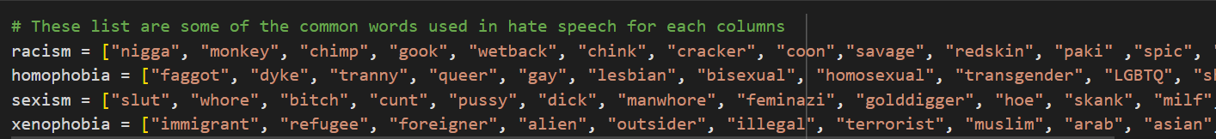
Data Collection:
Further classification

Slide 14
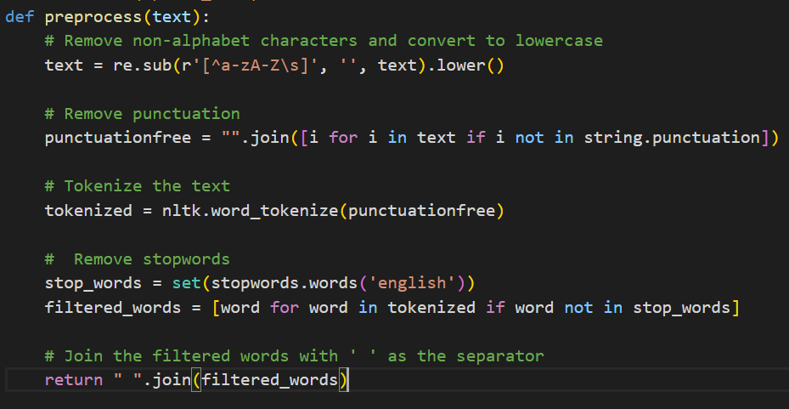
Data Preprocessing:
Clean text, remove non-alphabet characters, and tokenize.

Slide 15
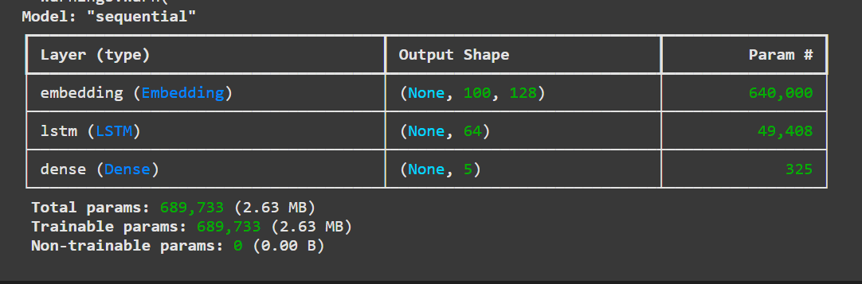
Model Training
Utilize LSTM & GRU models for classification.
Lstm

Slide 16
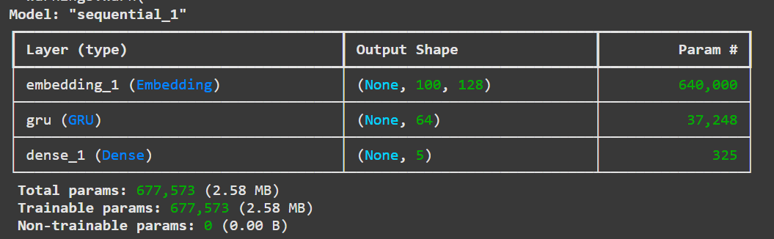
Model Training
GRU

Slide 17
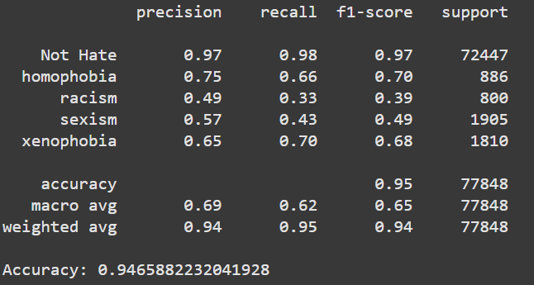
Evaluation
Measure accuracy, precision, recall, and F1 score.
LSTM

Slide 18
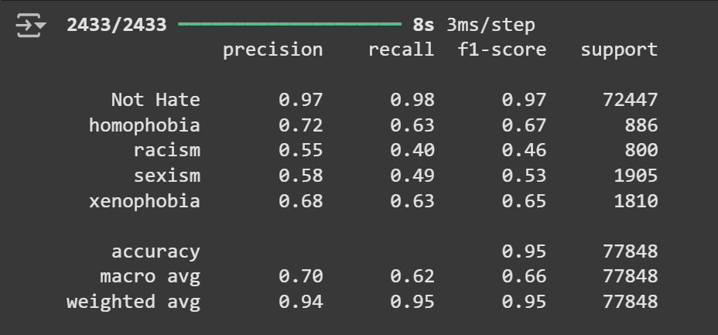
Evaluation
GRU

Slide 19
Demonstration

Slide 20
THANK YOU

